Slide 1


PLURALISTIC MEDIA FOR DEMOCRACY
AUDIENCE ENGAGEMENT AND COMMUNITY BUILDING
September 17, 2025

Slide 2

WHY AUDIENCE ENGAGEMENT MATTERS
Contributes towards a better understanding of audiences and their needs
Leads to stronger and more representative journalism
Helps to inform, connect & equip citizens with knowledge and tools they need to be active members of the society
Communities can sustain journalism, directly and indirectly, financially and by contributing their time and expertise
Fundamental part of journalism mission
Increases media viability
Notes:
No need to preach it to this group, as most of you are actively engaging with your audiences, but a reminder that audience engagement is crucial for every part and stage of media operations.

Slide 3
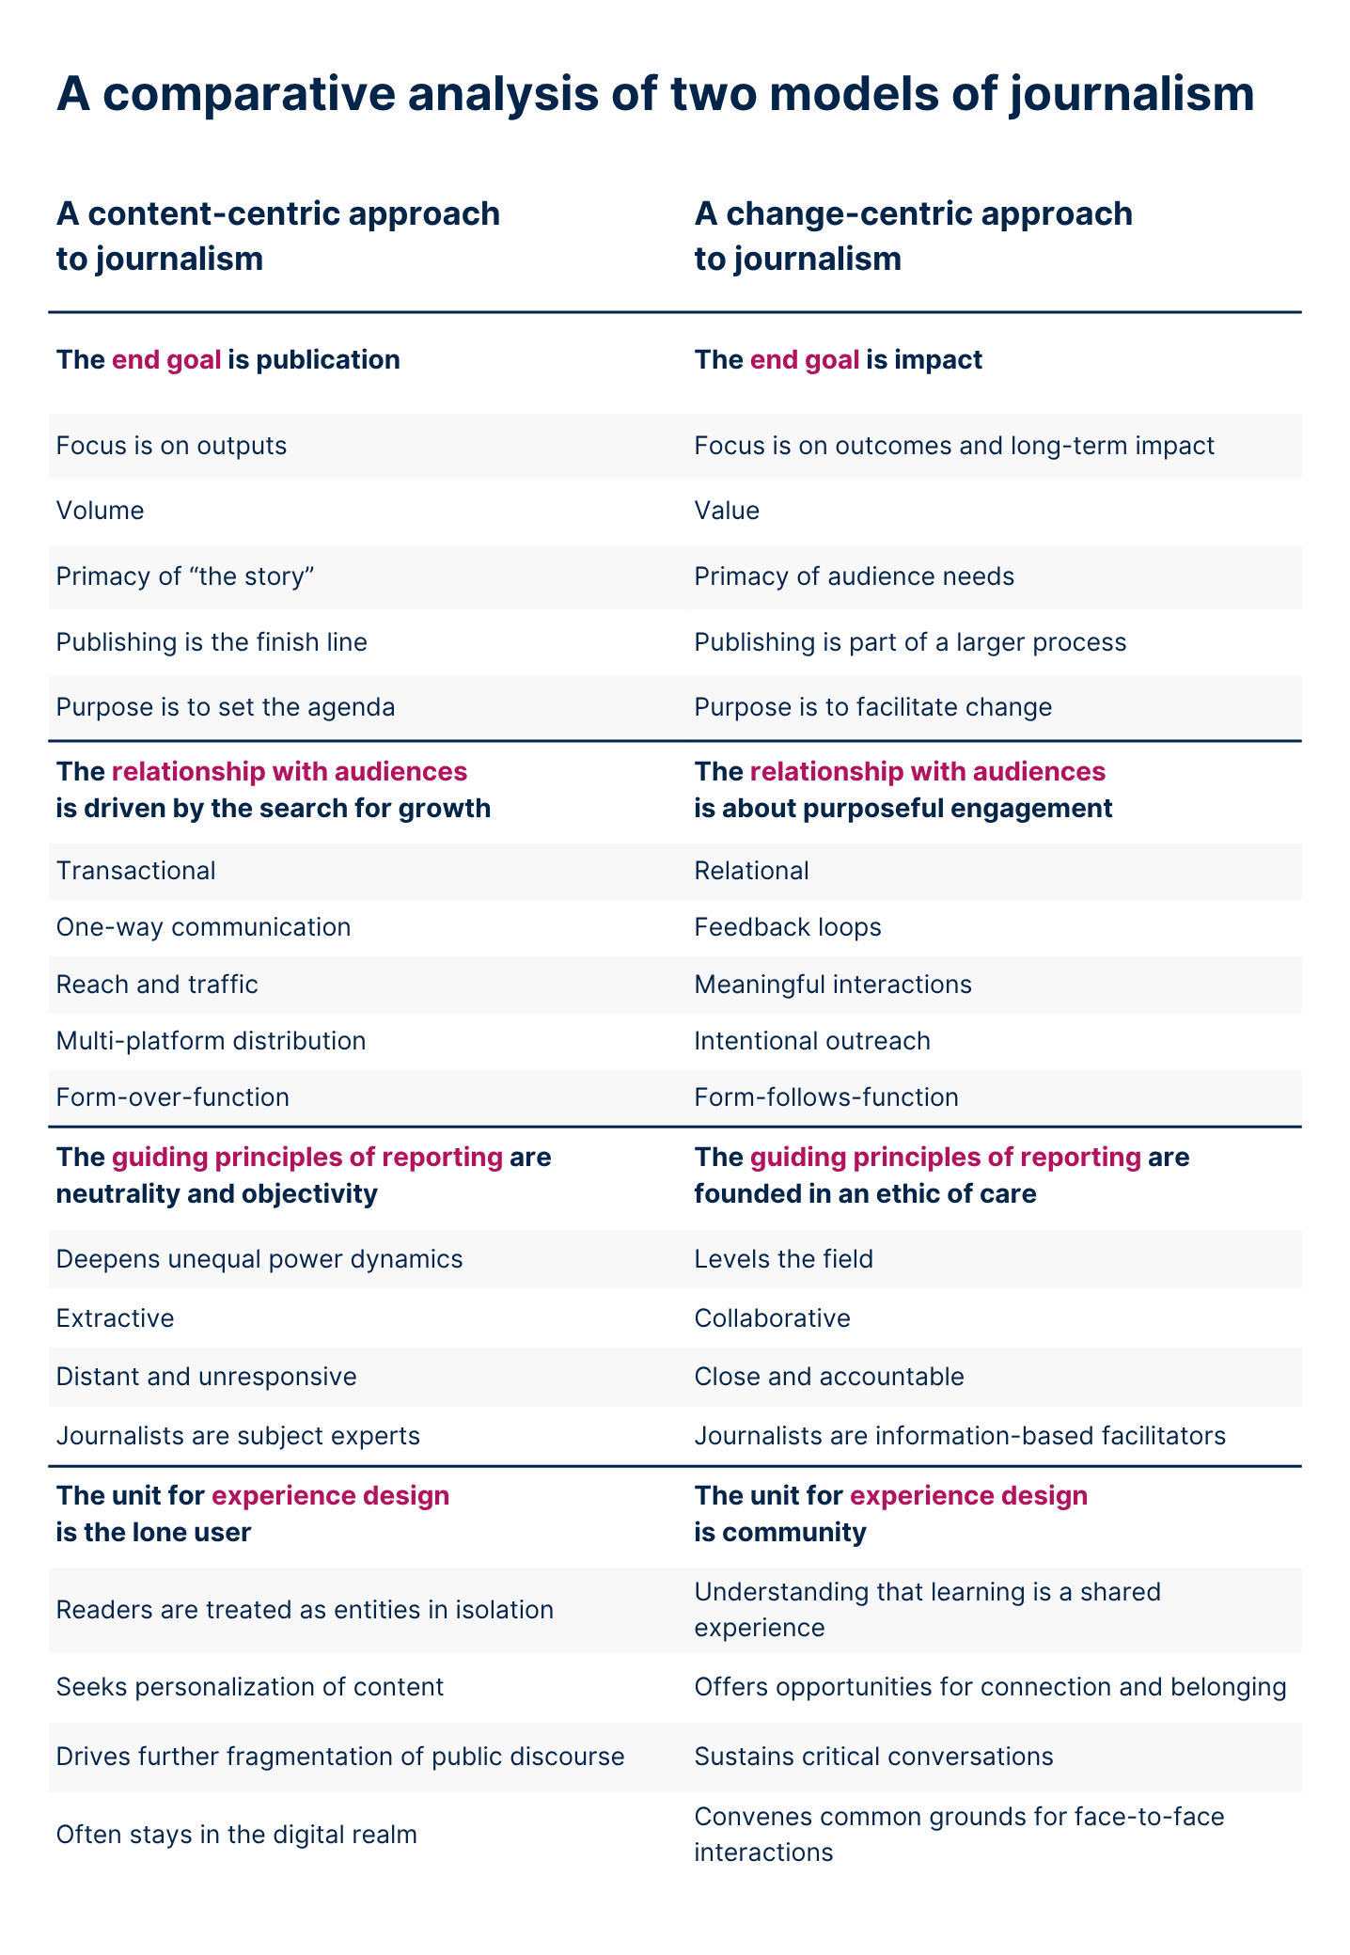
Content-centric vs.
Change-centric
Change-сentric framework draws on the practical experience of small-to-medium digital outlets with a preference for local and investigative work
🔍 The Change-Centric Journalism Framework
Notes:
A proposition to restore value and trust beyond the content model – published in Aug 2025, but result of years of experience and ideation. Concepts, methodologies and case studies that help to navigate it. Available in English and Spanish.
Who is it for: Editors and media leaders; subscription, membership or public service.
Let’s have a closer look at what engagement means in change-centric approach.

Slide 4
🔗 Platforms aren’t just distribution channels — they’re tools for strategic connections.
🎯 Every engagement effort should clarify two things: What is this story for, and who is it for?
🔁 When platforms are used with intention, engagement efforts create feedback loops that reveal what audiences find valuable, and why.
🤝 Instead of chasing visibility, it plans for meaningful interactions.
📣 Prioritises showing that audience voices resonate in the newsroom and that their participation matters.
Engagement in
change-centric model
The Change-Centric Journalism Framework

Slide 5
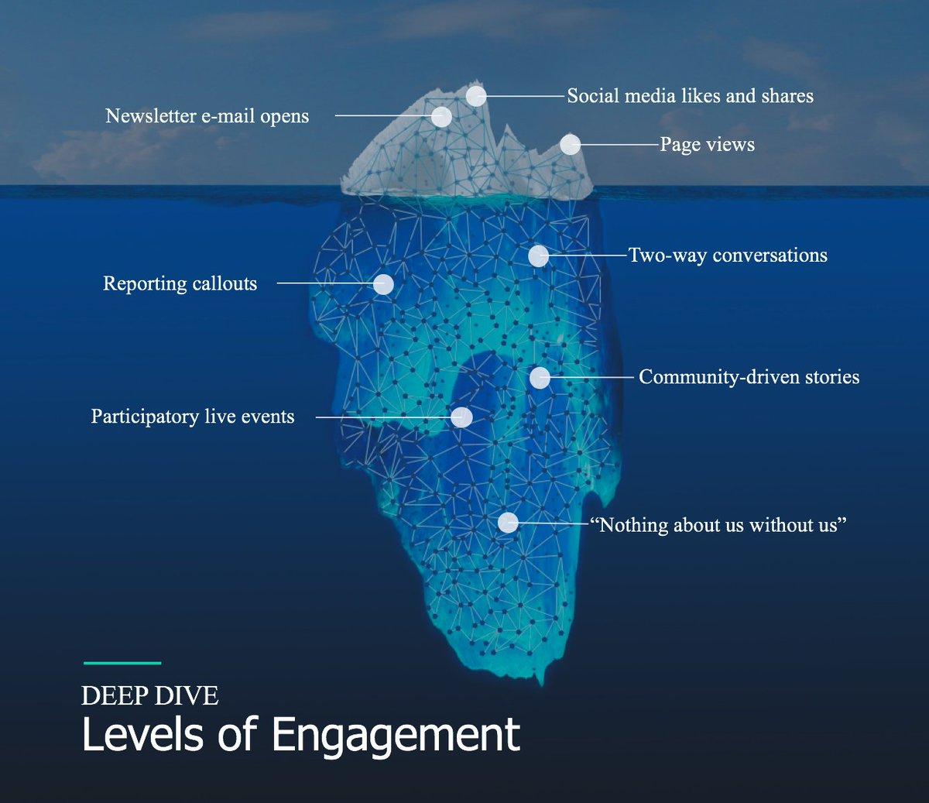
Types and levels of engagement
“Audience engagement is focused on building habit, loyalty, and audience revenue.
Community engagement is about understanding voids in the local ecosystem and positioning the newsroom to help fill those. ”
Ariel Zirulnick, senior editor for community engagement at Southern California Public Radio
Iceberg image from a presentation by Jackie Hai,
director of Journalism that Matters
Notes:
This is a visual way to think of these levels of engagement, and essentially the different depths. This is an iceberg model from Journalism that Matters, a nonprofit dedicated to fostering inclusive civic communications so that people, communities and democracy thrive.
The tip or the surface-level part of the iceberg is closer to audience engagement elements, while community engagement goes deeper and is characterised through approaches such as two-way conversations, reporting driven by communities, participatory events and beyond. It’s not an exhaustive list of options and there are others in between, but each level represents a different kind of depth of engagement we can have with people, from inviting their story ideas, to co-reporting, to involving community members in all our activities - “nothing about the community without the community”.
This model serves as an orientation tool. There are no “better” or “worse” levels – they service different purposes but understanding them helps to make any engagement meaningful. A media outlet doesn’t need to go all the way from the tip to the bottom of the iceberg or practice all types of engagement.

Slide 6
INFORM, ENGAGE, EQUIP
YOUR AUDIENCES
To inform is to … connect people’s interests to issues and analysis, and vice versa
To engage is to… build long-term relationships with people
To equip is to… provide access and opportunities for public participation and production (‘democratizing’ journalism skills and processes)
Notes:
This is a framework developed by Darryl Holliday, co-founder of City Bureau in Chicago, in 2019. Source: Darryl’s presentation at the Collaborative Journalism Summit.
In it, he outlines what I think is a very useful distinction between informing, engaging and equipping people: *** read out definitions and examples***
To inform is to…connect people’s interests to issues and analysis, and vice versa (so it’s YOUR reporting leading to a pothole being fixed; readers donating to a local charity; an audit of local government finances; the mayor to be fired for corruption); Radio FM99 example!
To engage is to…build long-term relationships with people (can lead to reader-driven questions; attendance at your newsroom events; crowdsourced editorial content; new relationships between citizens and newsrooms);
To equip is to…provide access and opportunities for public participation and production, also known as ‘democratising’ journalism skills and processes (so it’s the COMMUNITY who are empowered to cause a pithole to be fixed; a financial audit of local government to take place, the mayor to be fired for corruption, etc.). Example, City Bureau’s Documenters. Training and paying local citizens to attend and cover public meetings, and publishing the results in a free, daily digest. “Together we’re creating a new public record to shine a light on decisions being made in our city.”

Slide 7
1. Defining Audience – Clarify whom you serve and why they should care.
2. Purposeful Engagement – Define purposeful attention across the entire user journey and build meaningful relationships where it matters.
3. Measuring Success – Adopt a data-driven view of success, selecting metrics that map directly to business impact and user value.
4. Audience Development – Acquire skills and define clear roles, processes, and on- and off-platform tactics that turn strategy into repeatable action.
“In a digital information ecosystem, prioritising audiences – their needs and habits – is journalism’s most resilient foundation for growth and impact, enabling newsrooms not just to survive but to adapt with purpose.”
Elements of Audience Engagement
🔍Audience Engagement for Journalism Toolkit
For audience‑focused professionals who are ready to build purposeful, engaged communities that sustain their mission.
Notes:
A practical guide for developing a coherent audience engagement strategy for your media. Hyperlink to each of the elements.

Slide 8

🖥️ Massive Computing Power
All major social platforms now operate on large-scale neural networks, processing vast amounts of data—both user behaviour and content units.
📹 Video Content Explosion
Over the past five years, there’s been a surge in video content. Platforms have made breakthroughs in video analytics, enabling them to match and process enormous volumes of data.
🧠 Personalised Algorithms
Each user is served by a unique algorithm tailored to their behaviour and preferences.
👥 Cohort-Based Targeting
Platforms now group users into cohorts based on location, demographics, interests, values, and more—capturing the multidimensional nature of user.
Key Trends in Social Platforms

Slide 9
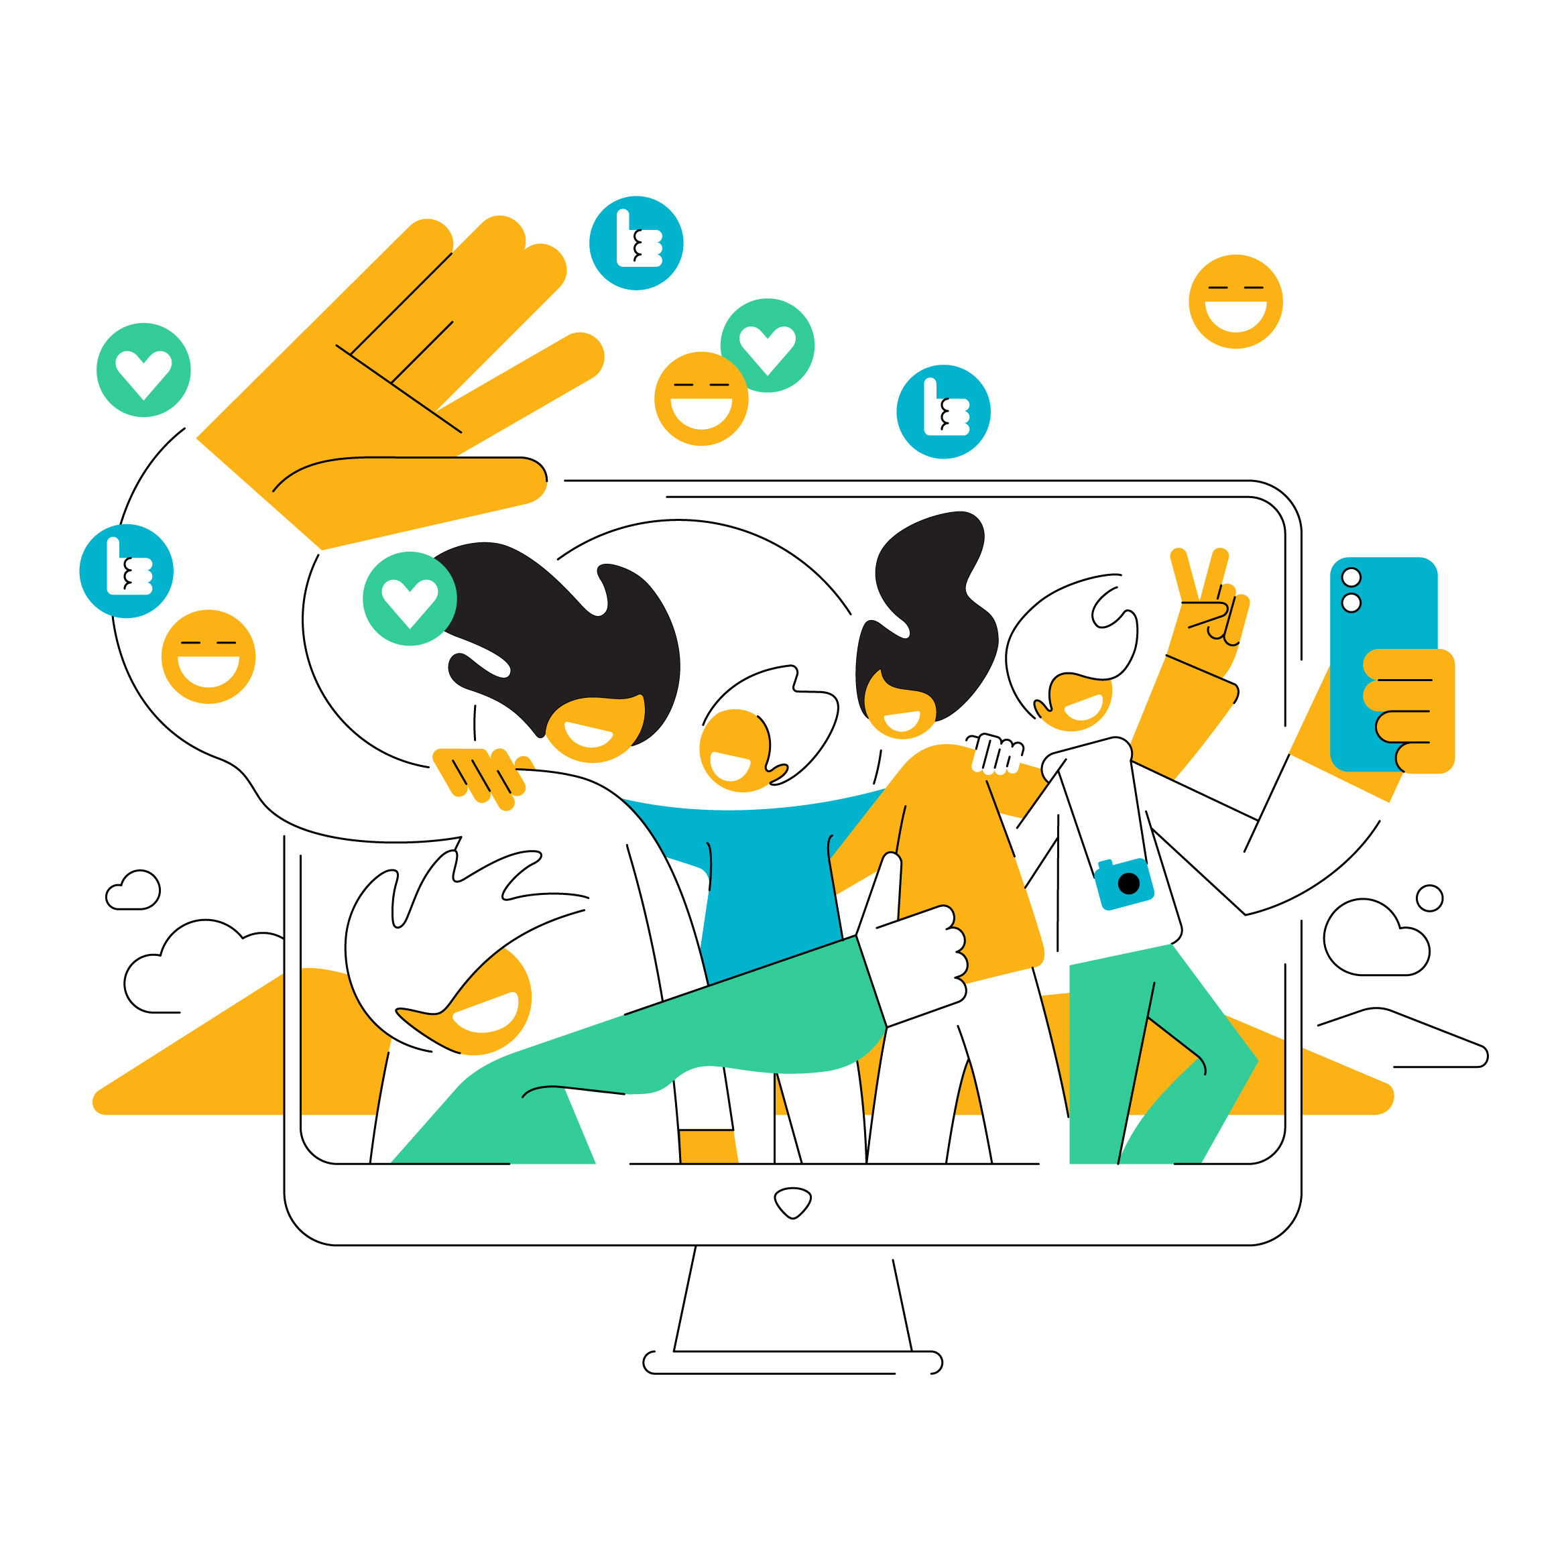
🧭 Define & Understand Your Audience Clearly
Using data and research methods or creating personas (for new audiences).
Editorial teams must continuously analyse audience interests at a granular level. Even when focusing on local or niche topics, users often engage with broad range of themes.
🪩 Build a Distinctive Brand
Every piece of content carries a brand. Media must project a strong, recognisable journalistic identity—anchored in values and uniqueness—not just deliver information.
💬 Foster Core Engagement
A loyal base of followers who consistently like and comment is essential. Platforms prioritise such content, amplifying it to similar users.
⏱️ Optimise for Watch Time
For video, completion rate is key. A 50–70% watch-through rate is considered excellent and increases platform promotion.
What This Means for Audience Engagement
Notes:
💡Vertical news video content drives views but offers limited long-term value for building a sustainable media brand.

Slide 10
Audience/Community Motivation Drivers
🔍 Discover: driven by curiosity
Residents are seeking the new and novel where they live — could be information and/or experiences that help them explore, pique their interest in or satiate their curiosity about the place they live in.
🤝🏻 Connect: driven by isolation
Residents are looking for meaning interactions, to meet their fellows and to find/join the community.
Notes:
What people may be driven by when they land on a story we’ve written, or come to a community event we’re hosting.
From an audience research piece done by Southern California Public Radio, a local radio station in Los Angeles (Source: SCPR, Medium). After interviewing listeners, they identified what they call ‘modes’ in which people in the community are at any given time, which influence what they need from the radio station’s content. Bear in mind these may not be entirely applicable to your newsroom and your community, but these broad categories can help you think of the ‘modes’ that people may be in when they interact with you, and thereby what benefit they can derive from that interaction.

Slide 11
Audience/Community Motivation Drivers
🚣‍♀️ Navigate: driven by confusion
Residents are seeking simplicity, clarity or guidance on something complex. This could include accessing essential information, services or resources, or understanding and solving a problem that affects their daily lives, their livelihoods or their future.
♻️ Change: driven by dissatisfaction or concern
Residents are looking for ways to do their part in contributing to positive change on issues that feel important to them. They want to make a meaningful difference, but might be lacking the information, connections or impetus to get started. Some are seeking to change themselves and their behaviors (e.g., living a more climate-friendly lifestyle) while others are seeking to make change in society.
Notes:
Navigate: Civio (Madrid, 2018). The Spanish government was changing the way people applied for the energy subsidy for vulnerable people. The process was now online and 1.85 million people in Spain were at risk of losing their tariff if they didn’t reapply within one month. The team worried that elderly people would miss out because BOSCO, the software created by the Spanish Ministry for Green Energy Transition, was very complex. Civio tried to lobby the authorities to simplify the application process, but nothing was done. Decided to create a web application that allowed people to fill in some basic details and find out if they were eligible for the tariff. If they were, the app explained what they needed to do to apply for the subsidy - the application itself was processed by the energy company. Led to increased donations for Civio, increased engagement (from people who were being wrongly dismissed or needed support), and to an investigation and appeal into the government’s software, which Civio determined was turning down applications from consumers who were actually eligible to these subsidies.

Slide 12
Choose the Right Platform
Communities can be built anywhere users can comment—even on TikTok.
→ Engagement thrives where interaction is possible.
Define Message, Rules, and Moderation
Every community needs a clear purpose, rules, and active moderation.
→ Structure builds trust and sustainability.
Focus on Interests, Not Just Geography
Communities grow stronger when built around shared interests.
→ Think in cohorts: values, passions, and behaviours.
Building Communities: Where & How
💡Community can be one or a mix of:
Geographical: people living in a specific place
Topical: people who care about a given topic
Community of interest: people that have a shared identity or experience

Slide 13

Balance Issues with Positivity
Don’t just highlight problems—generate positive emotions.
→ Themes like nostalgia, future vision, and exclusivity drive engagement.
Bridge Online and Offline
Use online platforms to organise offline events—and vice versa.
→ Each activity fuels the other, strengthening community ties.
Use Creative Tools for Direct Connection
Go beyond platform features—leverage all available tools and creative solutions to build direct relationships with community members.
→ Collect emails, require event registration, and track participation to better understand your audience’s interests and offer tailored content products that help bridge communities.
Building Communities: Where & How

Slide 14
❤️‍🔥 Reel Like Insights
See exactly which moments in your Reel triggered likes.
→ Helps identify what content resonates most and refine your creative approach.
🖼️ Carousel Like Insights
Discover which slide in your carousel prompted a like.
→ Enables data-driven decisions—e.g. where to place your call to action.
📊 Post-Level Demographics
View demographic breakdowns for each post and Reel.
→ Understand who your content is reaching and tailor accordingly.
📈 Top Follower Drivers
See in one place which posts and Reels converted viewers into followers.
→ Learn what drives growth and how to replicate success.
🔎 Search Engine Visibility (Spring 2025)
Instagram posts are now indexable by search engines.
→ Local and niche content is more discoverable—account permission required.
Instagram: Important Updates
🔍Instagram Insights Updates

Slide 15

TAKEAWAYS
⏳ Engagement takes time and (human) resources
With a multitude of platforms, formats, and methods, audience engagement demands time and human resources. Focus on those that best serve your strategic goals.
🤝 Community engagement is about trust
It’s about building relationships. That means showing commitment and making systematic, consistent efforts.
🧪 Experiment. Learn. Adapt.
Try new things, embrace quick learning, and don’t fear failures—they’re part of the process.
📱 Stay tuned to social platforms
Most interactions happen there—and they’re constantly evolving. Keep up to stay relevant.
🤗 Connect with your PM4D peers
There’s a wealth of knowledge in this group—reach out, exchange ideas, and learn from each other.
AUDIENCE ENGAGEMENT AND COMMUNITY BUILDING
September 17, 2025

